Slide 1
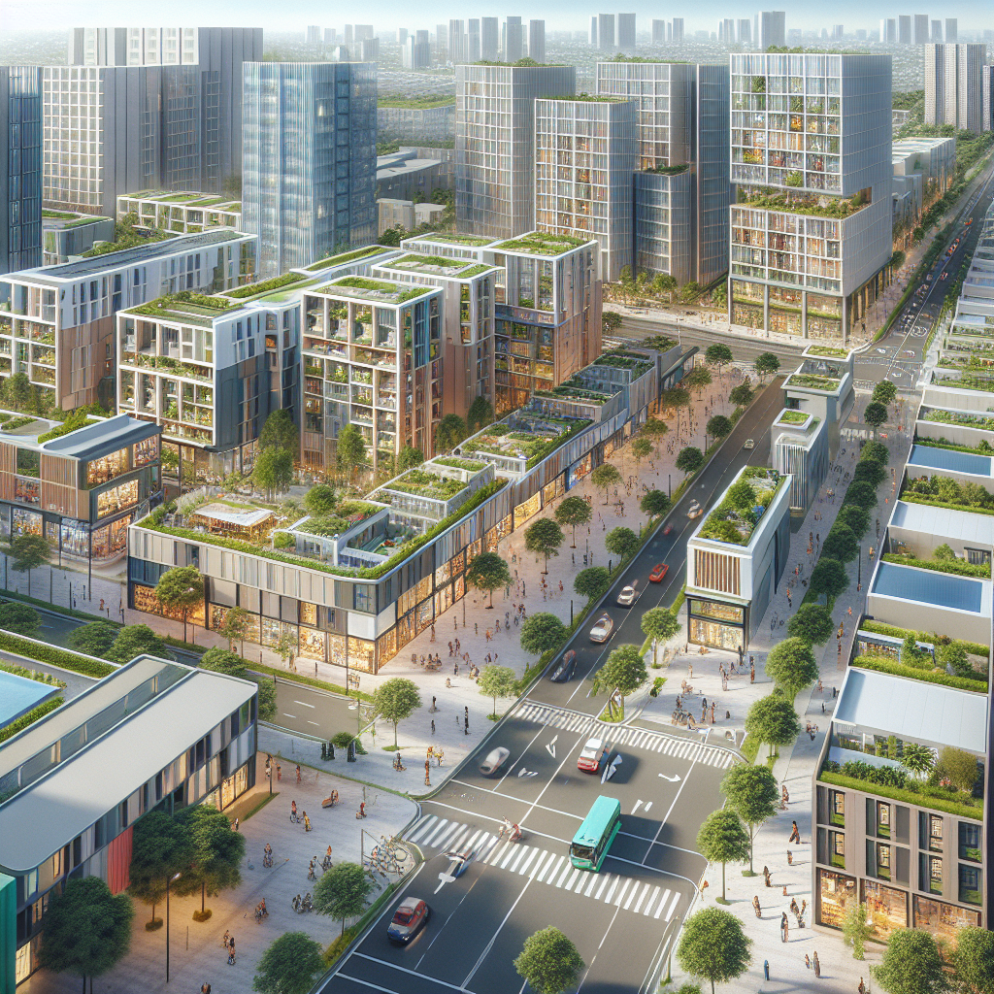
Mixed‑Use Zoning Toolkit
Form‑Based Codes: Regulate form and frontage, not just use; ensure active ground floors.
Missing‑Middle Housing: Triplexes, courtyard apts, ADUs to diversify options near services.
Adaptive Reuse: Convert offices/big‑box to housing, schools, clinics.
Parking Reform: Eliminate minimums; use maximums/shared/cash‑out; price curbs.
Inclusionary Zoning: Reserve % of units as affordable near transit/amenities.
Corner Commercial Allowance: Small‑format retail/childcare/cafés embedded in residential blocks.
Policy Note: Pair zoning with grants/TA for small developers and main-street businesses.

